Slide 1
What is OOPS

Slide 2
What are four pillars of OOP?
Essential information required to identify any object with out its detail. Information can be attribute or action or both.
Or
The process of formulating general concepts by abstracting common properties of instances.
Abstraction
Encapsulation
Inheritance
Polymorphism
Encapsulation is mechanism to achieve abstraction
Any attribute or immaterial possession that is inherited from ancestors
Polymorphism (from the Greek meaning "having multiple forms") is the characteristic of being able to assign a different meaning or usage to something in different contexts

Slide 5
Generalization Vs Specialization
Shape
Square
Circle
Triangle
Generalization
Specialization by Implementation

Slide 6
Generalization Vs Specialization
IShape
Square
Circle
Triangle
Generalization
Specialization by Implementation

Slide 7
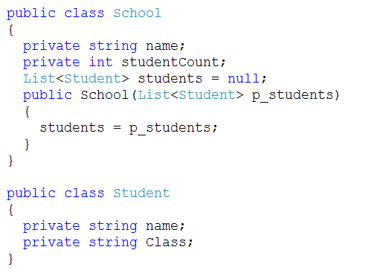
Aggregation

Slide 8
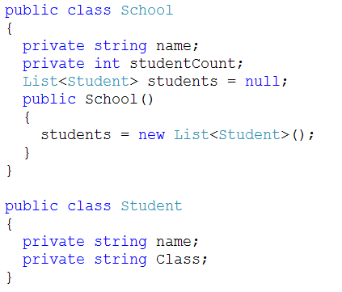
Composition (Has a relationship)

Slide 9
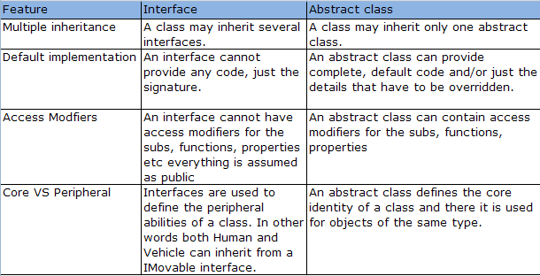
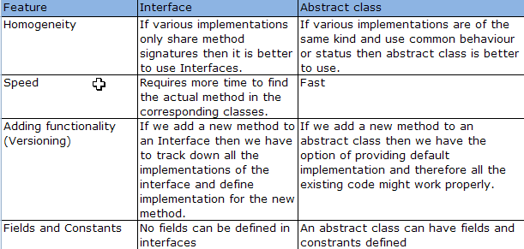
When to use interface and when to use abstract class?

Slide 10
Design Principle
Single Responsibility
Open-Closed
Liskov Substitution
Interface Segregation
Dependency Inversion

Slide 11
Open-Closed Principle (OCP)
"Software Systems change during their life time"
both better designs and poor designs have to face the changes;
good designs are stable
Software entities should be open for extension,
but closed for modification
B. Meyer, 1988 / quoted by R. Martin, 1996
Be open for extension
module's behavior can be extended
Be closed for modification
source code for the module must not be changes
Modules should be written so they can be extended
without requiring them to be modified

Slide 12
Single Responsibility
Changing code in a tested class can introduce new bugs. We seek to minimize the reasons why a class might need to change. The more different things a class does, the more reasons it might have to change.

Slide 13
Interface Segregation
If different clients depend on different methods of the same class, then a change to one method might require a recompile and redeployment of other clients who use different methods. Creating several client-specific interfaces, one for each type of client, with the methods that type of client requires, reduces this problem significantly.

Slide 14
Dependency Inversion
Much of the duplication in code comes from client objects knowing about all sorts of specialized suppliers, that from the clients perspective do similar things but in different ways. Polymorphism is a powerful mechanism that underpins OO design. It allows us to bind to an abstraction, and then we don’t need to know what concrete classes we are collaborating with. This makes it much easier to plug in new components with no need to change the client code.

Slide 15
Liskov Substitution
Dynamic polymorphism is a powerful mechanism that allows us to invert dependencies, reducing duplication and making change much easier. All OO design principles depend upon polymorphism, but we must ensure that any type can be substituted for any of its subtypes at run-time without having any adverse effect on the client. Subtypes must obey all of the rules that apply to their super-types pre-conditions for calling methods, post-conditions of methods called, and invariants that always apply between method calls.

Slide 16

Common design patterns
Creational Patterns
Factory Method
Abstract Factory
Builder
Singleton
Structural Patterns
Adapter
Behavioral Patterns
Observer
Iterator
Others
MVP
DI

Slide 17
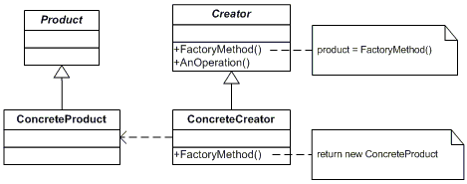
Factory pattern
Define an interface for creating an object, but let subclasses decide which class to instantiate. Factory Method lets a class defer instantiation to subclasses.

Slide 18
Code (factory Pattern)

Slide 19
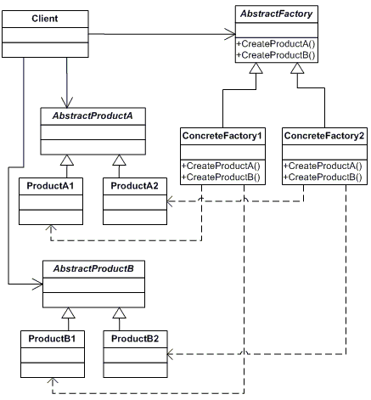
Abstract Factory
Provide an interface for creating families of related or dependent Objects without specifying their concrete classes.

Slide 20
Code(Abstract factory)

